Slide 1
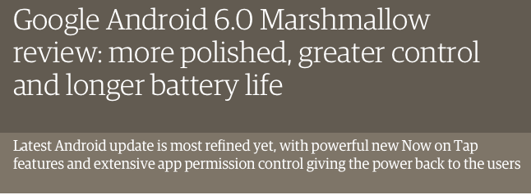
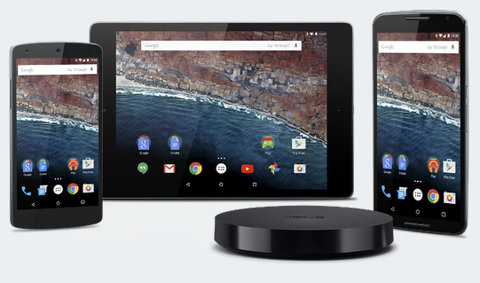

Slide 2
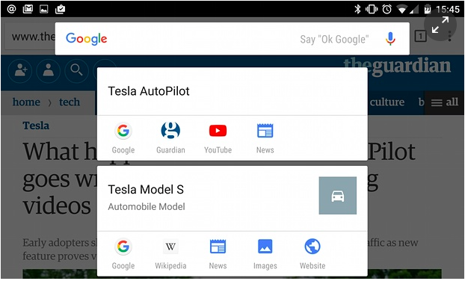
Now On Tap
Biggest New Feature
Extension of Google’s Learning Digital Assistant Google Now
Gives power to read what is on a user’s screen
Provide users information on what they might want to see
Google’s competitor to Apple’s Siri and Microsoft’s Cortana
Different Ways to use the App: Restaurants, Music, People, Movies
Fire up the system by holding the home button down
Scans the screen and suggests searches or information
Uses ecosystem for recognition of actors, movies, TV shows, phone #s….

Slide 3
Android M Permissions
Users
Developers
Easy to install and update
Can change permissions using Revoke in Settings
Apps will not ask for user’s permission during install time
Users will be informed on why an app is not working
Permission changes takes place right away
Permission is unique to each user
Installation changes for target sdk 22+
Aware of permissions granted even legacy
Request “critical” permissions at runtime
Request permissions for “extra” features

Slide 4
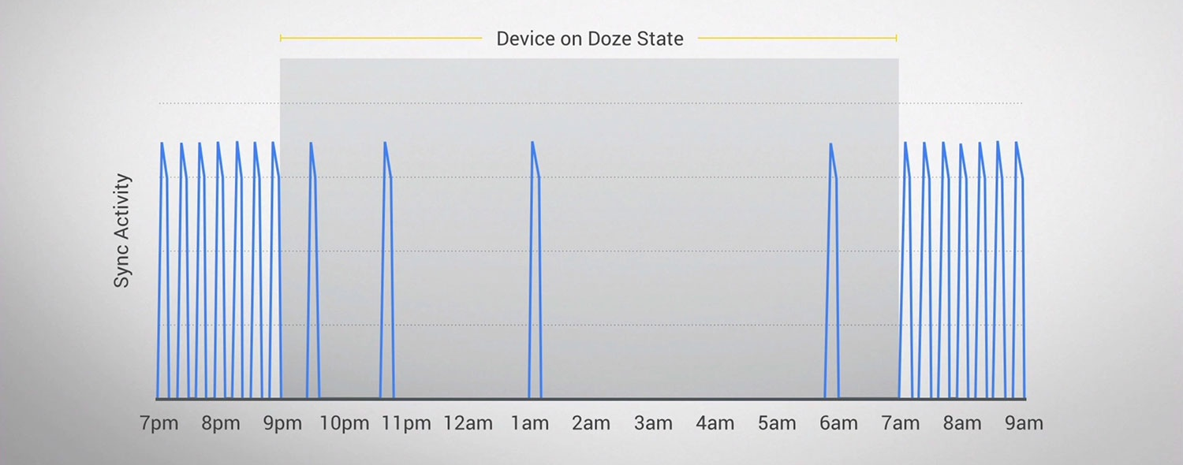
Power Optimization
Doze Features
Deep Sleep mode to save battery
Reduced sync activity
Activated when screen is off and phone not moving
Doze for developers
App developers can bypass Doze with high-priority
App notifications pass through Google Cloud Messaging server
Google can track down abusive developers

Slide 5
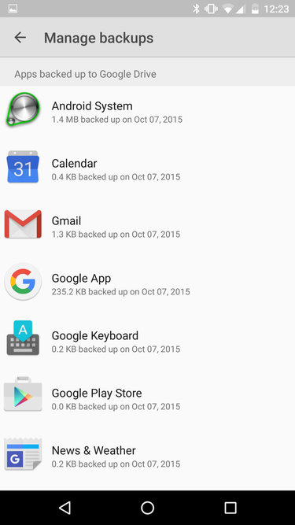
Auto Backup
Apps
Stores app data, settings, and logins to Google Drive
Updates every 24 hours if JobScheduler API allows
Allows seamless transition to new device
Developers
Determine what app data is backed up
Side-loaded apps also backed up

Slide 6
Security
Fingerprint Integration
Integration of fingerprint validation to Google services allows for easier access to sensitive applications.
BoringSSL
Google switched to a forked repo of the open source SSL library to allow tighter integration with google implementations.
Network Identifier
Removal of programmatic access to network identification for apps using wifi or bluetooth.
Application performing background wifi or bluetooth scan will appear as a randomized MAC address.

Slide 7


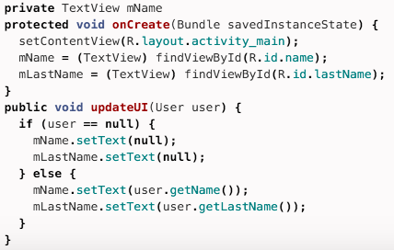
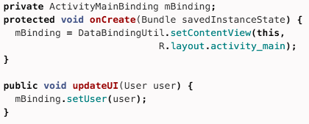
Data Binding
Java classes can be bound from layout to activity
Reduces unnecessary boilerplate code
Allows expressional statements in xml layout code
Old
New

Slide 8
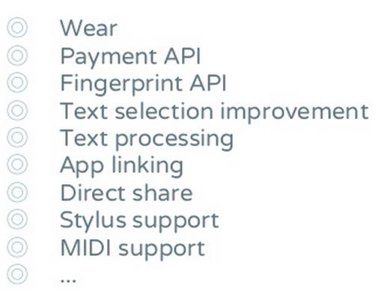
More?

